Slide 1
Breast Cancer Classification
Research Project Presentation on Deep Learning Techniques

Slide 2

Introduction
This system is a diagnostic support tool designed to
automatically classify medical breast cancer images
as either benign or malignant using a trained
Convolutional Neural Network (CNN) model.
The objective of the system is to provide a modular,
and scalable solution that helps in early and
accurate detection of breast cancer

Slide 3
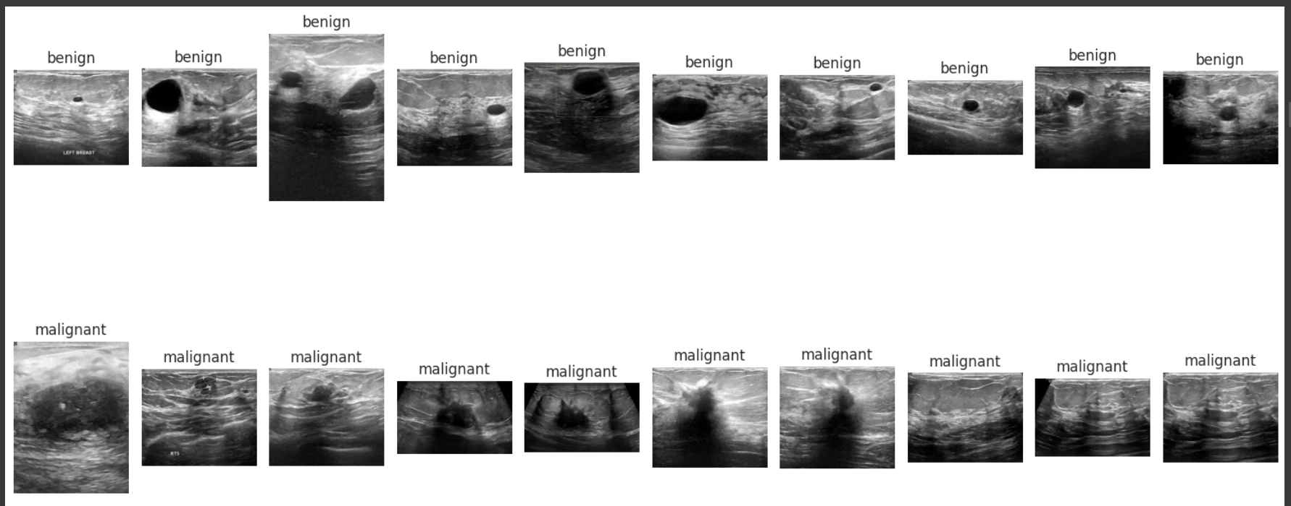
Features of the Dataset
The dataset comprises 277,524 image patches, each
measuring 50x50 pixels, extracted from 162 whole
slide images of breast cancer specimens scanned at
40x magnification.
The images are in RGB format, suitable for training
Convolutional Neural Networks (CNNs) and other deep
learning models.

Slide 4
Dataset size and source
Number of images: 277,524 image patches
Image size: Each image is 50×50 pixels, in RGB color (so 3 channels).
Classes: Two classes — IDC Positive (cancerous) and IDC Negative (non-cancerous).
Breast Histopathology Image: https://www.kaggle.com/datasets/paultimothymooney/breast-histopathology-images

Slide 5
Model Used
The following model architectures and techniques have
been integrated into the system for performance
comparison and analysis:
CNN + Random Forest
CNN + XG-Boost
CNN + Transformer Model
CNN + Inception V3 (Transfer Learning)

Slide 6
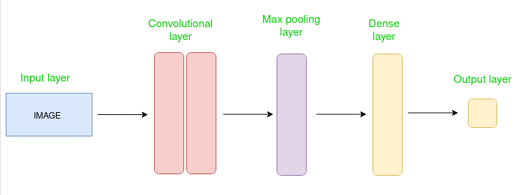
Details on CNN architectures
Layers of CNN:
Convolution Layer: Detects features like edges and textures using filters.
ReLU Activation: Introduces non-linearity by replacing negative values with zero.
Pooling Layer: Reduces the size of the feature maps to make the model faster and avoid overfitting.
Flattening: Converts the 2D output into a 1D vector.
Fully Connected Layer: Combines all features to predict the output.
Output Layer: Gives the final prediction (e.g., cancerous or non-cancerous).

Slide 7
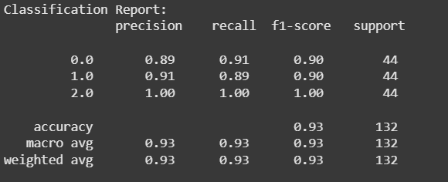
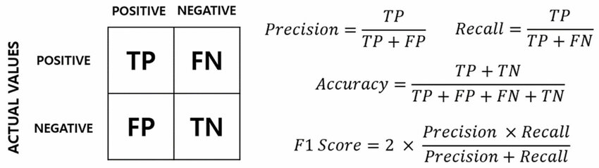
Evaluation Metrics
The evaluation of model performance was primarily
based on accuracy, precision, and recall, which provide
insights into the effectiveness of the classification results.

Slide 8
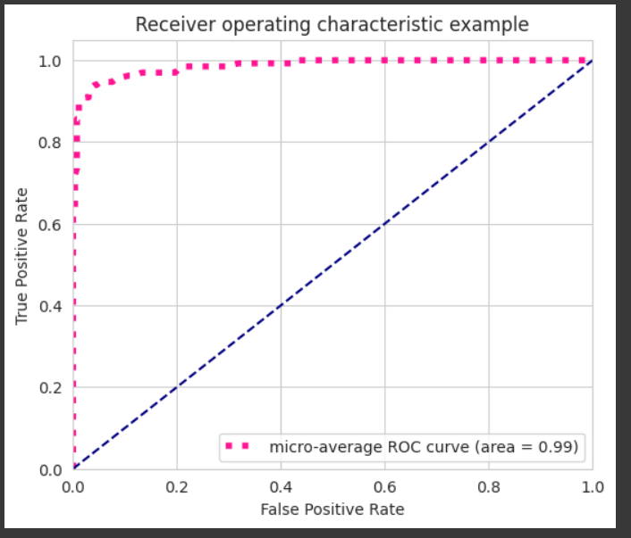
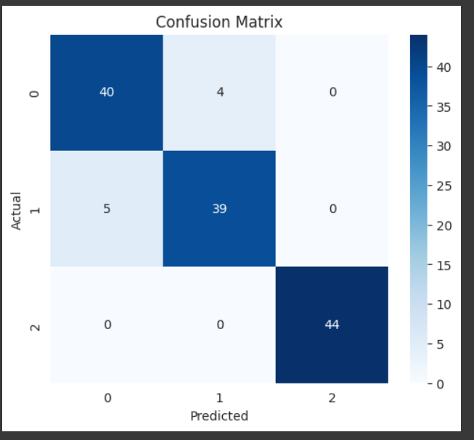
AUC-ROC Curve and Confusion Matrix
The AUC-ROC curve helps us check how well our model can tell the
difference between two classes (like cancerous and non-cancerous).
AUC (Area Under the Curve) gives a score between 0 and 1 — a score
closer to 1 means the model is very good at making correct predictions.
This is very important in medical tests because making mistakes
(false positives or false negatives) can have serious consequences.
A confusion matrix shows how well the model is doing by comparing the correct and wrong predictions.
It helps us see exactly where the model is strong and where it needs improvement.

Slide 9
Conclusions
The "Breast Cancer Classification Using Deep Learning" project successfully aims to build a reliable and accurate diagnostic support system using Convolutional Neural Networks (CNNs).
It focuses on early detection of breast cancer by classifying medical images as benign or malignant with a target accuracy of over 93%.
The system is designed for research, educational use, and assisting healthcare professionals, ensuring high performance, reliability, and portability.

Slide 10
Thank You!
Utkarsh Kishor CS-2341383
Lakshya CS-23411328
Please keep this slide for attribution

